Slide 1
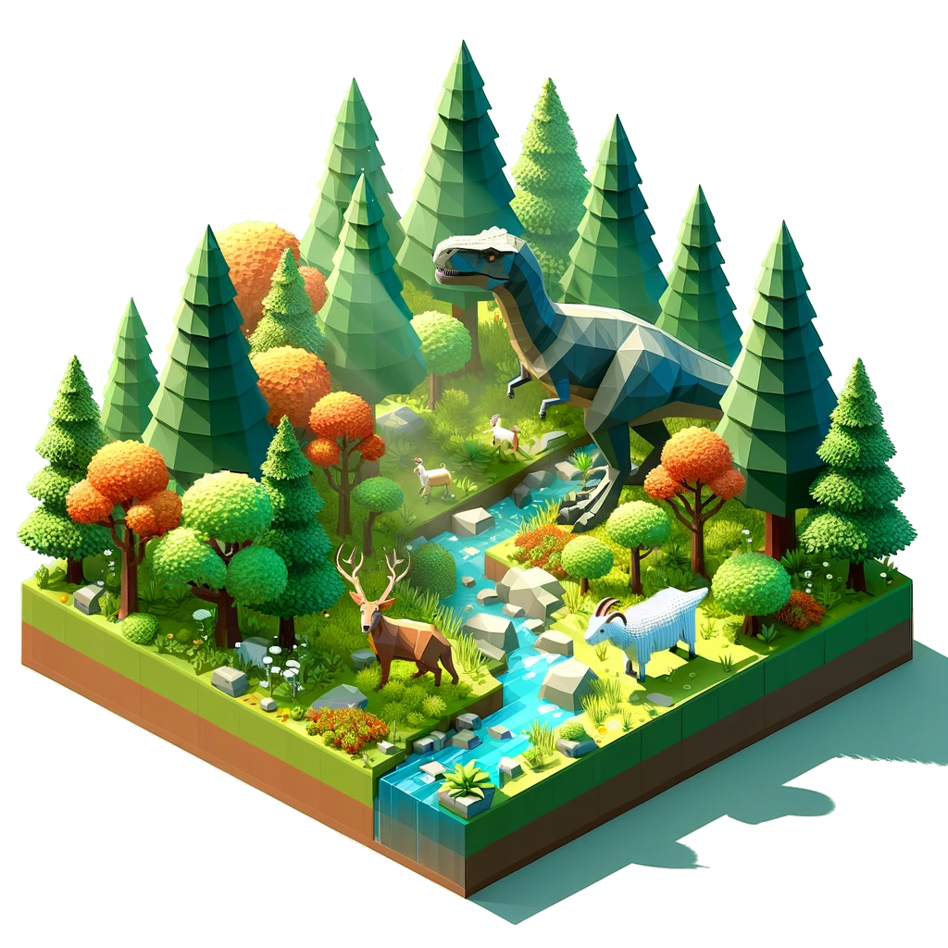
Untitled God Game
Embark on a Divine Journey in Virtual Reality

Slide 2
Welcome to UGG
A Groundbreaking VR game where players become gods.
Explore a procedurally generated universe, teeming with life and endless possibilities.
Harness the power to create, alter, and oversee evolving virtual world.

Slide 3
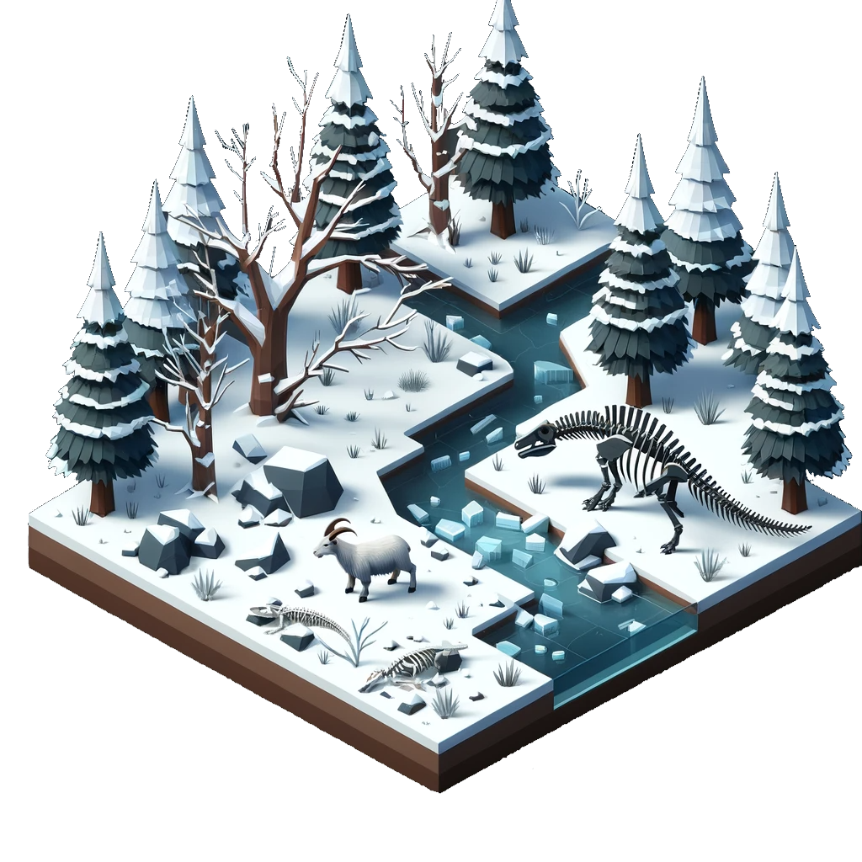
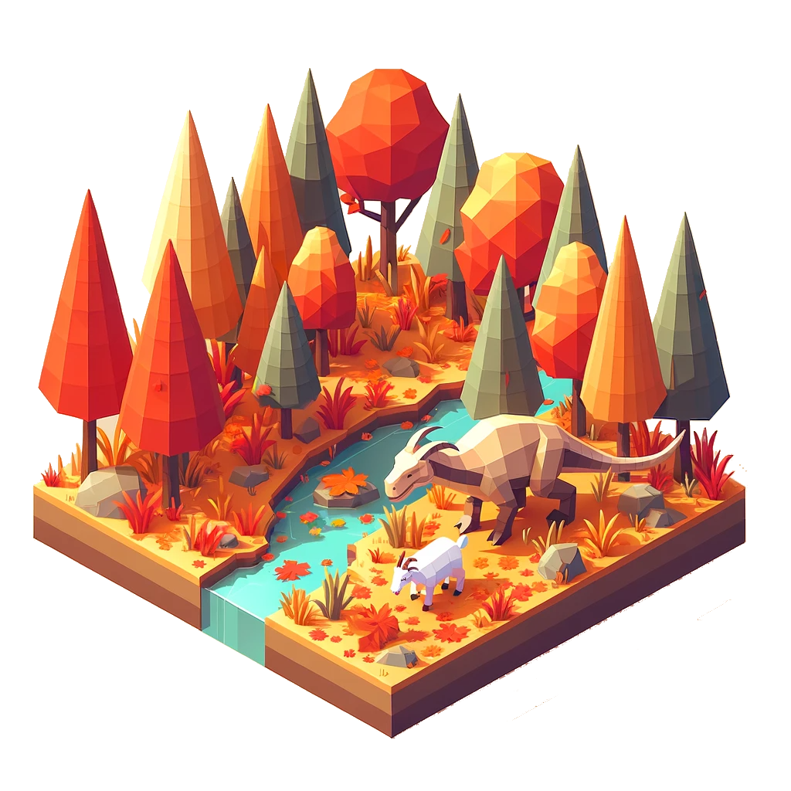
Crafting Infinite Worlds
Experience unique landscapes every time, from towering mountains to serene oceans.
Discover a spectrum of environments.

Slide 4
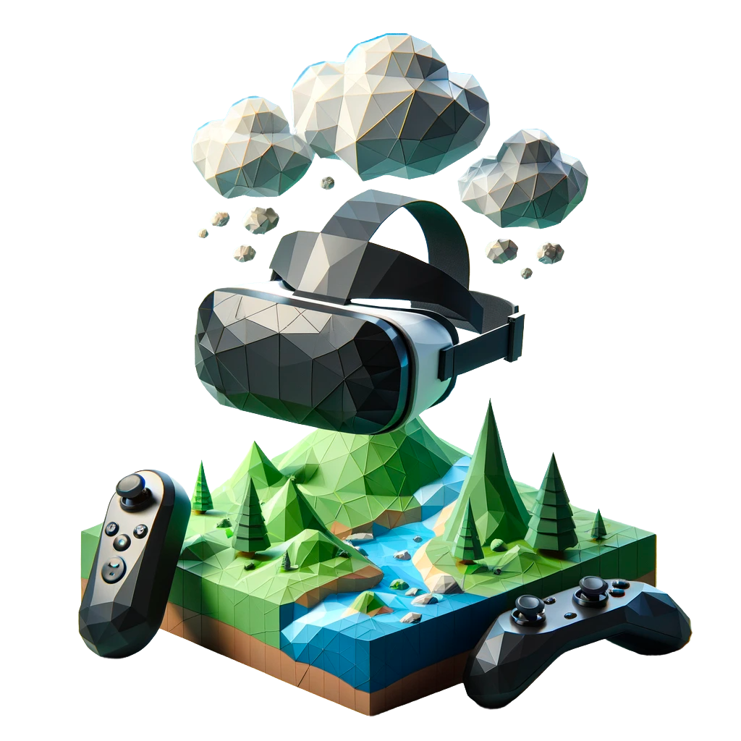
Divine Powers at Your Fingertips
Terraforming Abilities: Sculpt the land to your will – raise mountains, form lakes, and grow forests.
Control the Weather: Summon rain for growth, conjure storms for challenge, or bring sunshine for tranquility.
Miracles and Wonders: Perform awe-inspiring acts, from nurturing life to manifesting natural phenomena.

Slide 5
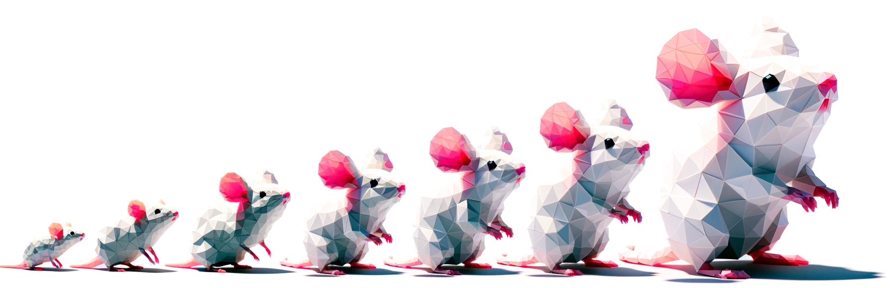
Life Evolves Around You
Intelligent Life Forms: Creatures with unique behaviors and traits, shaped by their genetics and environment.
Natural Selection in Play: Witness the survival of the fittest as species adapt, evolve, or perish over time.
Ecosystem Interactions: Each creature plays a role in the food chain, affected by player actions and natural events.

Slide 6
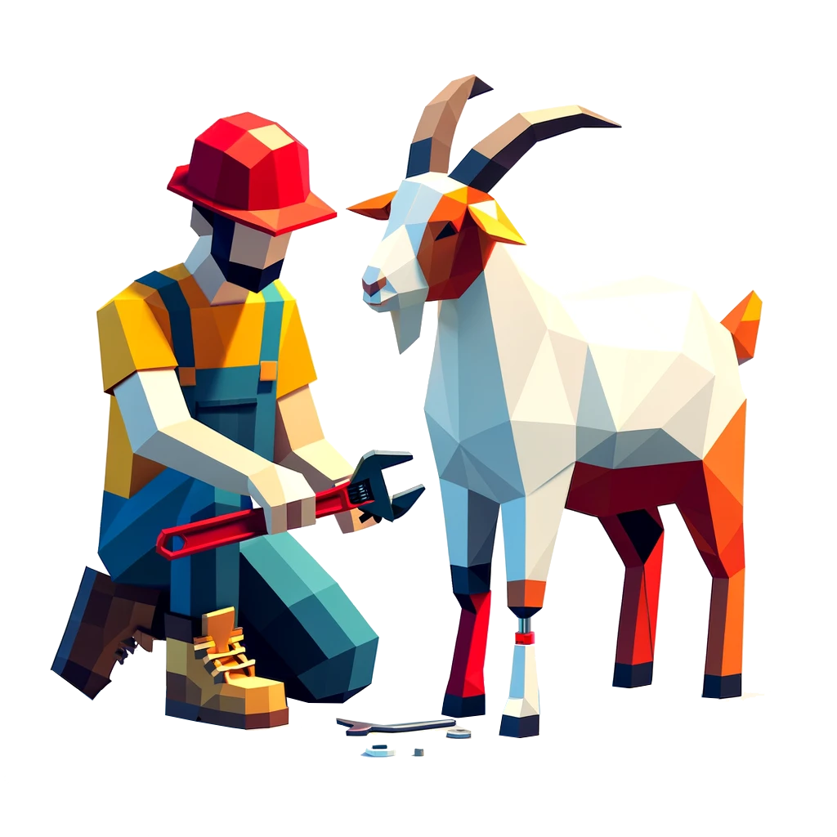
Powered by Godot Engine
Leveraging Godot's Flexibility
Fully open source project

Slide 7

Shaping the Future of UGG
Ascend to godhood in our upcoming VR game. Shape life, wield power. Are you ready to play deity?

